Slide 1
TinyLFU: A Highly Efficient Cache Admission Policy
Gil Einziger and Roy Friedman
Technion
Speaker: Gil Einziger

Slide 2
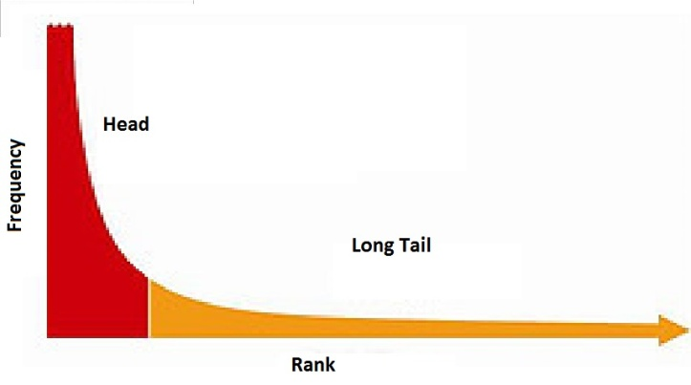
Caching Internet Content
The access distribution of most content is skewed
  Often modeled using Zipf-like functions, power-law, etc.
A small number of very popular items
For example~(50% of the weight)
Frequency
Long Heavy Tail
For example~(50% of the weight)
Rank

Slide 3
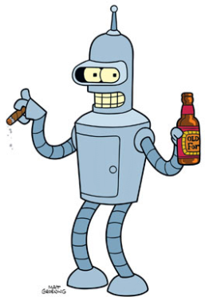
Caching Internet Content
Unpopular items can suddenly become popular and vice versa.
Blackmail is such an ugly word. I prefer "extortion".
The "X" makes it sound cool.‬
Frequency
Rank

Slide 4
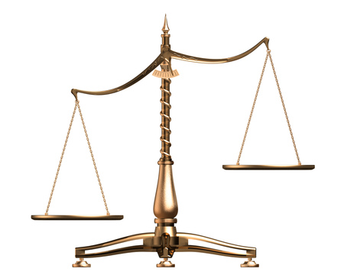
Caching
Any cache mechanism has to give some answer to these questions…
Admission
Eviction
However…
Many works that describe caching strategies for many domains completely neglect the admission question.

Slide 5
Eviction and Admission Policies
Cache Victim
New Item
Eviction Policy
Admission Policy
Winner
One of you guys should leave…
is the new item any better than the victim?
What is the common Answer?

Slide 6

Frequency based admission policy
The item that was recently more frequent should enter the cache.
I’ll just increase the cache size…

Slide 7
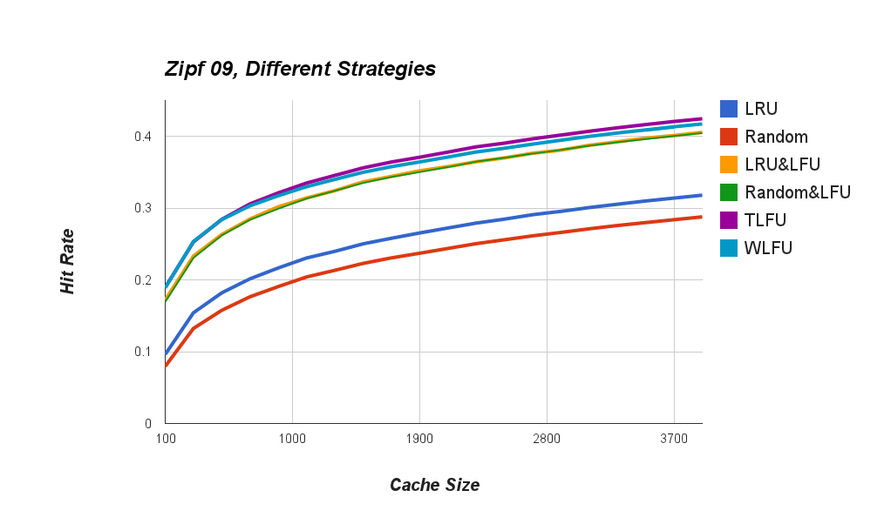

Larger VS Smarter
But what about the metadata size?
Frequency based admission policy
Hit Rate
Better cache management
Without admission policy
More memory
Cache Size

Slide 8
Window LFU
A Sliding window based frequency histogram.
A new item is admitted only if it is more frequent than the victim.
1
2
3
2
1
3

Slide 9
Eliminate The Sliding Window
Keep inserting new items to the histogram until #items = W
#items
7
8
9
10
5
Once #items reaches W - divide all counters by 2.
1
2
1
3
4
2
1
2
1
3
1

Slide 10


Eliminating the Sliding Window
Correct
  If the frequency of an item is constant over time… the estimation converges to the correct frequency regardless of initial value.
Not Enough
  We still need to store the keys – that can be a lot bigger than the counters.

Slide 11


What are we doing?
Approximate
Past
Future
It is much cheaper to maintain an approximate view of the past.

Slide 12
Inspiration: Set Membership
A simpler problem:
  Representing set membership efficiently
One option:
  A hash table
Problem:
  False positive (collisions)
  A tradeoff between size of hash table and false positive rate
Bloom filters generalize hash tables and provide better space to false positive ratios

Slide 13
Inspiration: Bloom Filters
An array BF of m bits and k hash functions {h₁,…,h_{k}} over the domain [0,…,m-1]
Adding an object obj to the Bloom filter is done by computing h₁(obj),…, h_{k}(obj) and setting the corresponding bits in BF
Checking for set membership for an object cand is done by computing h₁(cand),…, h_{k}(cand) and verifying that all corresponding bits are set
BF=
1
1
1
√
h₁(o1)=0, h₂(o1)=7, h₃(o1)=5
m=11, k=3,
Not all 1.
×
h₁(o2)=0, h₂(o2)=7, h₃(o2)=4

Slide 14
Counting with Bloom Filter
A vector of counters (instead of bits)
A counting Bloom filter supports the operations:
  Increment
    Increment by 1 all entries that correspond to the results of the k hash functions
  Decrement
    Decrement by 1 all entries that correspond to the results of the k hash functions
  Estimate (instead of get)
    Return the minimal value of all corresponding entries
CBF=
4
3
8
6
9
7
k=3, h₁(o1)=0, h₂(o1)=7, h₃(o1)=5
m=11
Estimate(o1)=4

Slide 15
Bloom Filters with Minimal Increment
Scarifies the ability to Decrement in favor of accuracy/space efficiency
  During an Increment operation, only update the lowest counters
MI-CBF=
3
4
8
6
k=3, h₁(o1)=0, h₂(o1)=7, h₃(o1)=5
m=11
Increment(o1) only adds
to the first entry (3->4)

Slide 16
Small Counters
A naïve implementation would require counters of size Log(W). Can we do better?
Assume that the cache size is bounded by C(<W)
  An item belongs to the cache if its access frequency is at least 1/C
  Hence, the counters can be capped by W/C (Log(W/C) bits)
Example:
  Suppose the cache can hold 2K items and the window size is 16K => W/C=8
  Each counter is only 3 bits long instead of 14 bits

Slide 17
Even Smaller Counters
Observation:
  In Skewed distributions, the vast majority of items appear at most once in each window
Doorkeeper
  Divide the histogram into two MI-CBFs
    In the first level, have an unary MI-CBF (each counter is only 1-bit)
    During an increment, if all corresponding bits in the low level MI-CBF are set, then increment the corresponding counters of the second level

Slide 18
TinyLFU operation
MI-CBF
Bloom Filter
Estimate(item):
  Return BF.contains(item) +MI-CBF.estimate(item)
Add(item):
  W++
  If(W == WindowSize)
    Reset()
  If(BF.contains(item))
      Return MI-CBF.add(item)
    BF.add(item)
    Reset
  Divide W by 2,
  erase Bloom filter,
  divide all counters by 2.
  (in MI-CBF).

Slide 19
TinyLFU example
Cache Victim
New Item
Eviction Policy
TinyLFU
Winner
TiyLFU Algorithm:
Estimate both the new item and the victim.
Declare winner the one with higher estimate

Slide 20
Example
MI-CBF
(3 bit counters)
Few small counters
Many 1-bit counters
Bloom Filter (1 bit counter)
Numeric Example: (1,000 items cache)
1-Bit Counters
(~7,200 items)
3-Bit counters (~500 items)
Cache Size (1000)
Statistics Size (9,000)
1.22 bits per counter,
1 byte per statistic item,
9 bytes per cache line.

Slide 21
Simulation Results:
Wikipedia trace (Baaren & Pierre 2009)
“10% of all user requests issued to Wikipedia during the period from September 19th 2007 to October 31th. “
YouTube trace (Cheng et al, QOS 2008)
Weekly measurement of ~160k newly created videos during a period of 21 weeks.
We directly created a synthetic distribution for each week.

Slide 22
Simulation Results: Zipf(0.9)
Hit Rate
Cache Size

Slide 23
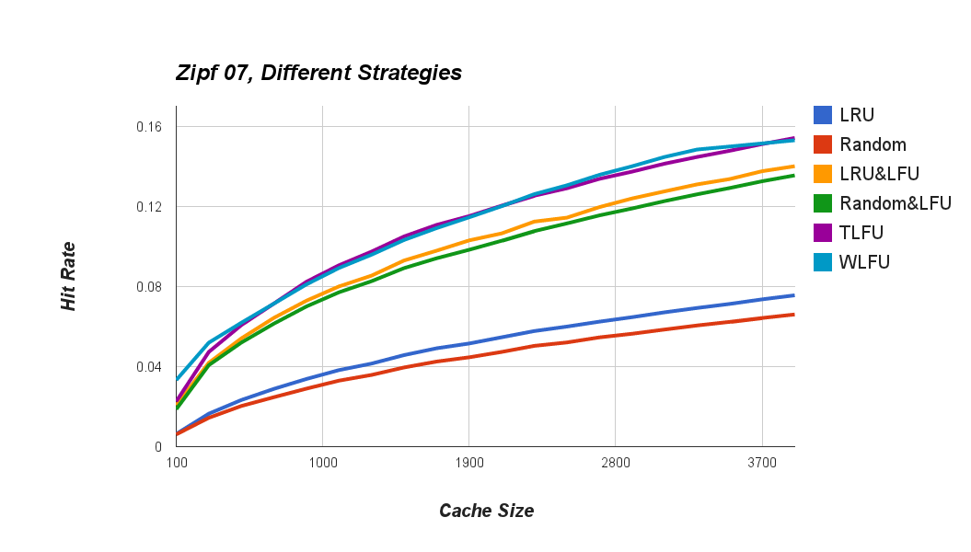

Simulation Results: Zipf(0.7)
Hit Rate
Cache Size

Slide 24
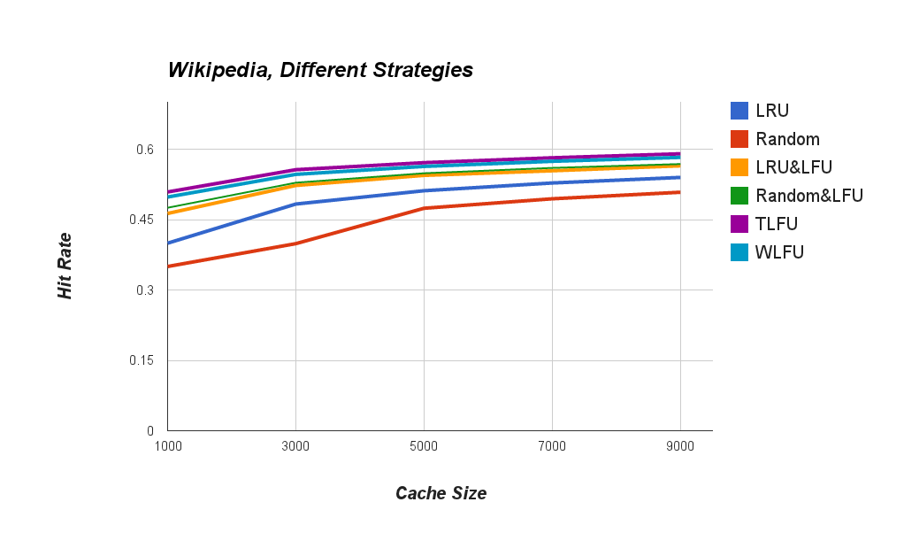
Simulation Results: Wikipedia
Hit Rate
Cache Size

Slide 25
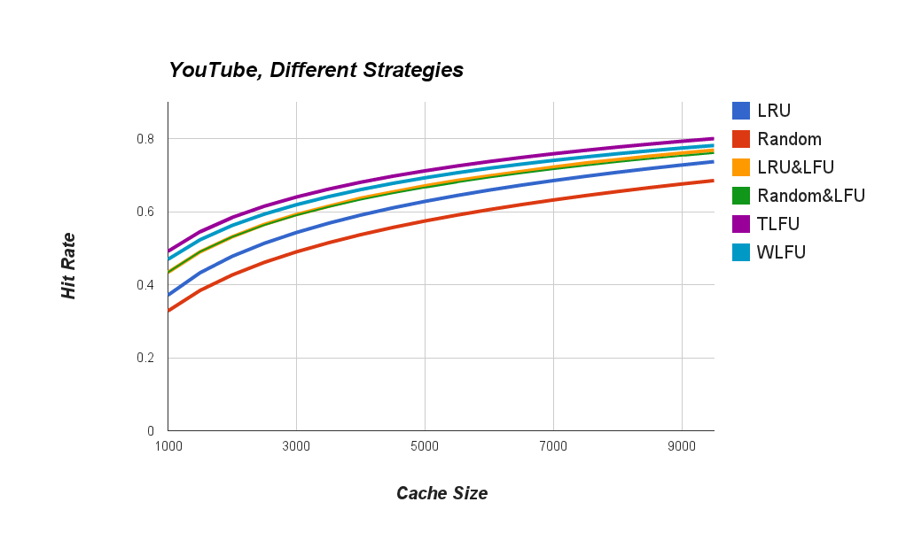
Simulation Results: YouTube
Hit Rate
Cache Size

Slide 26
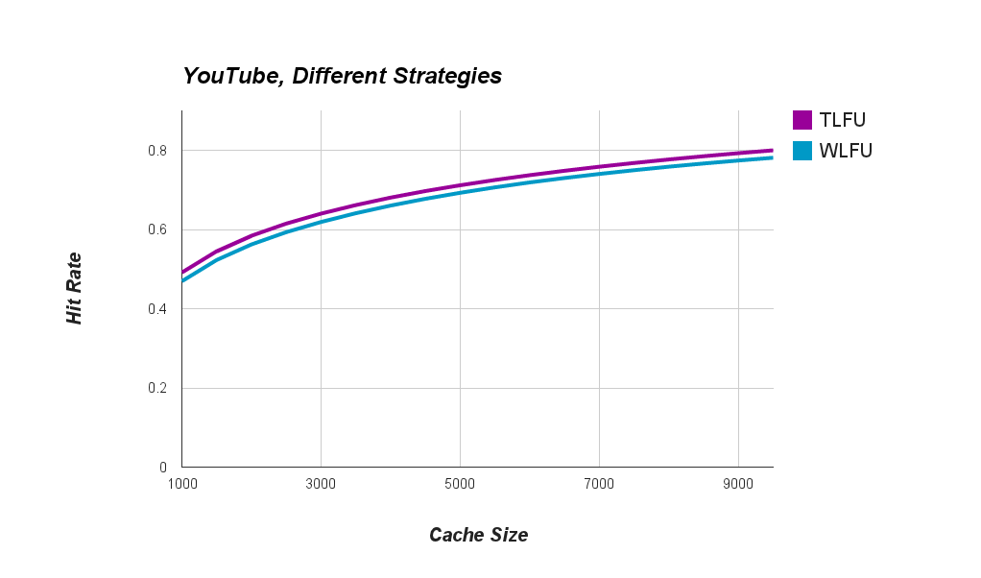


Comparison with (Accurate) WLFU
Comparable performance… but ~95% less metadata.
Hit Rate
Cache Size

Slide 27
Additional Work
Complete analysis of the accuracy of the minimal increment method.
Speculative routing and cache sharing for key/value stores.
A smaller, better, faster TinyLFU.
  (with a new sketching technique)
Applications in additional settings.

Slide 28
Thank you for your time!

